Slide 1

Arabic Sentiments Analysis
Supervised by:
Ali Alkhathlan

Slide 2
Content
Introduction
Problem statement
What is the solution
What is the chosen dataset
What is the data preparation method
How to convert text to numbers
What the machine learning algorithms will be used
Flow chart of the project
Timeline of the project
Conclusion

Slide 3
Introduction
Sentiment Analysis indicates the use of Natural Language Processing (NLP) and Machine Learning to specify and extract subjective information in a piece of text. Sentiment Analysis is powerfully useful as it enables us to obtain an overview of the wider public opinions (e.g., happy, sad, and anger) towards certain topics, products, or services. It is the method of determining the emotional tone behind a series of words, used to understand the attitudes, opinions, and emotions expressed within a web review. In general, Sentiment Analysis requires identifying four elements comprising entity, its aspect, opinion holder, and his sentiment. The extracted opinions can be classified as either objective or subjective text. The subjective text also can be classified as positive or negative or natural sentiments.

Slide 4
Sentiment Analysis importance for the Arabic language
Obtain an overview of the wider public opinions
The lack of interest in terms of applications of artificial intelligence, including machine learning and deep learning
Assisting decision-makers and business managers also general public users
Important aspect within the global economy and international politics.

Slide 5
Problem statement
The problem is that we need to make a machine recognize the compliments reviews and the criticism reviews so that we can use these classified reviews to get many benefits, the store funder needs to know how many users like a product and how many user dislikes it (it shouldn’t be product maybe service), so if the reviews classified into two classes its can be use the negative classes to see what is the thing that the user was obsessed about.

Slide 6
Solution
We will tackle the problem of Sentiment analysis by using machine learning algorithms.
- The input of the model is a sequence of words
- The output is weather the input has a positive or negative sentiment
Thus, it is a classification problem.
The pipeline of our approach is as follow:
First need to look for datasets for ASA that are ready to use.
Second, we must prepare/clean the input text, cleaning data involves in removing stop words, punctuation and diacritics.
Third, since machine learning algorithms do not work on raw texts directly, we must convert texts to numeric values (vectors), that is called feature extraction.

Slide 7
Solution (Cont.')
A simple and effective feature extraction model for vectorizing texts is called Bag of Words (BOW).
Two algorithms follow the BOW concept that are:
CountVectorizer
Term Frequency-Inverse Document Frequency (TF-IDF).
Fourth, after vectorizing our text input, we will train our machine learning algorithms and develop our classifiers.
Algorithms such as Support Vector Machine, Logistic regression, and more will be used. We finally test our model based on the performance metrics found on the literature.

Slide 8
Datasets
We used different data set in our project that include different reviews:
Attraction Reviews
Hotel Reviews
Movie Reviews
Product reviews
Restaurant reviews
Consist of number of examples for each class: Positive, Negative, and Neutral.

Slide 9
Data preparation methods
Gather data.
Discover and assess data.
Cleanse and validate data.
Removing extraneous data and outliers.
Filling in missing values.
Conforming data to a standardized pattern.
Masking private or sensitive data entries.
Transform and enrich data.
Store data

Slide 10
Text conversion to numbers
Bag Of Words (BOW) approach
CountVectorizer
TF-IDF

Slide 11
CountVectorizer
Is Count the number of times each word appears in a document
Example :
“this book is good”, “this movie is bad”, “the app is not good”.
“this book is good”
“this movie is bad”
“the app is not good”

Slide 12
TF-IDF
Its like CountVectorizer but instead of Count the number of times each word appears in the document its TF*IDF score.
TF-IDF is an information retrieval technique that weighs a term’s frequency (TF) and its inverse document frequency (IDF). Each word or term that occurs in the text has its respective TF and IDF score. The product of the TF and IDF scores of a term is called the TF-IDF weight of that term.
Put simply, the higher the TF-IDF score (weight), the rarer the term and vice versa.

Slide 13



N-gram method
“the app is not good”
1-gram
2-gram
3-gram

Slide 14
Machine learning algorithms
Naïve bayas
Random forest
Support vector machine
Logistic regression

Slide 15
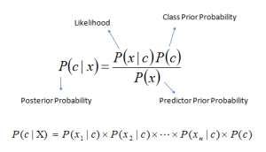
Naïve bayas
It is a classification algorithm based on Bayes’ Theorem
In simple terms, a Naive Bayes classifier assumes that the presence of a particular feature in a class is unrelated to the presence of any other feature.

Slide 16
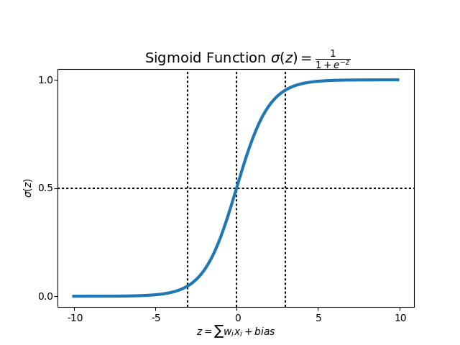
Logistic regression
Logistic Regression is a classification Machine Learning algorithm, it is a predictive analysis algorithm and based on the concept of probability.
Logistic regression algorithm uses hypothesis and a sigmoid function to make a prediction, so what is hypothesis and sigmoid function.

Slide 17
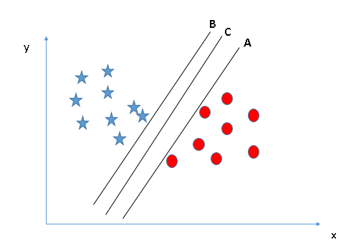
Support vector machine (SVM)
Support Vector Machine (SVM) machine learning algorithm which can be used for both classification or regression challenges. In the SVM algorithm, we plot each data item as a point, and we perform classification by finding the best decision boundary that differentiates the two classes very well.

Slide 18
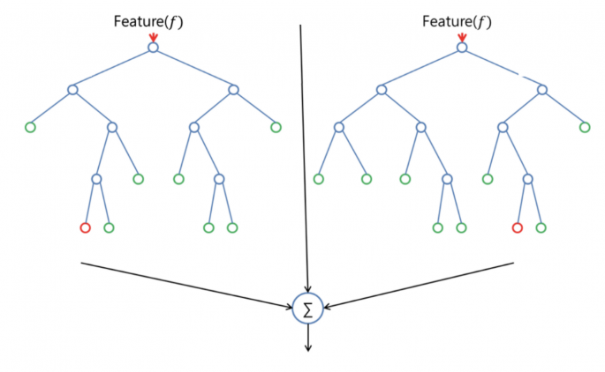
Random forest
Random forest is a classification algorithm, that use bagging method by combining a lot of decision trees together, that is why they call it forest.

Slide 19
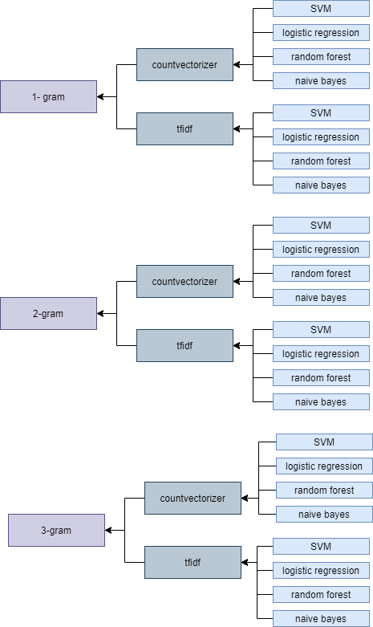
experiments
We will not perform these algorithms from scratch, we will use some APIs to make it easy and fast. We will make 24 experiment and we will choose the best accuracy to use it in a GUI app.

Slide 20
Flow chart of the project
The project will go through 3 phases.
Data preprocessing.
Training & testing
GUI app
There is a flow chart for every phase. And the phases one and two are performing just one time after that we will extract the model and use the model in phase 3 when we are using GUI app.

Slide 21
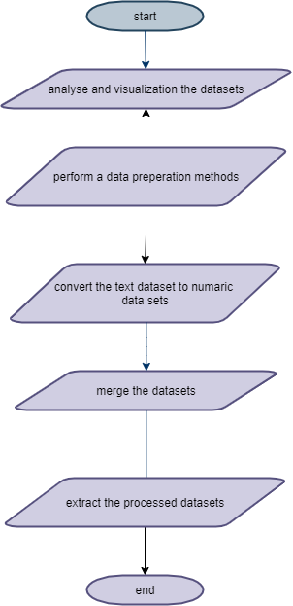
Data prerpocessing

Slide 22
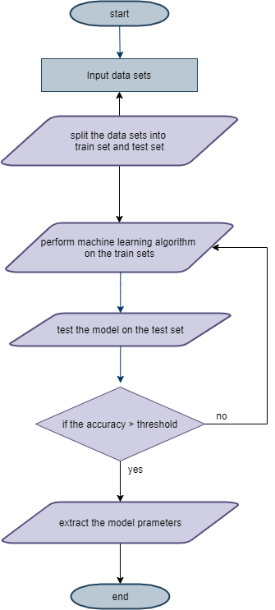
Training & testing

Slide 23
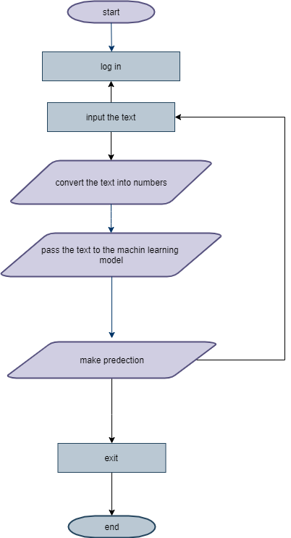
GUI app

Slide 24
Equipment or software will be used
The equipment we will used:
Aziz supercomputer.
Software we will used:
Python programing language.
NumPy API, for linear algebra operation.
Scikit-learn API, for machine learning and conversion text to number algorithms.
Pandas API, for data preprocessing.
PyCharm IDE, for python programing language.
IntelliJ IDE, for GUI and UX/UI designing.
Those software and equipment can change in the future.

Slide 25
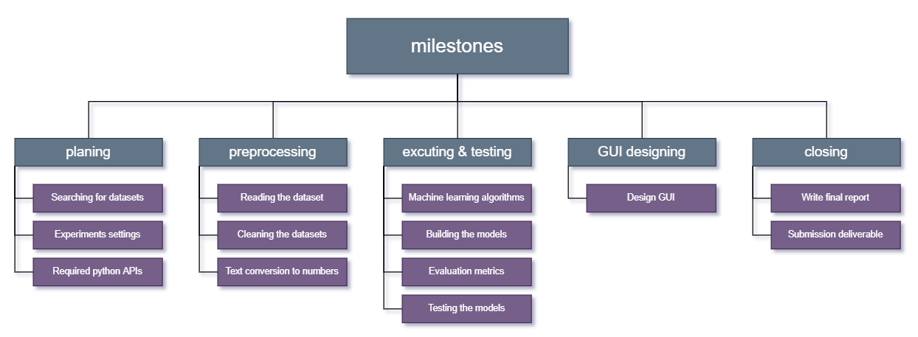
Milestones

Slide 26
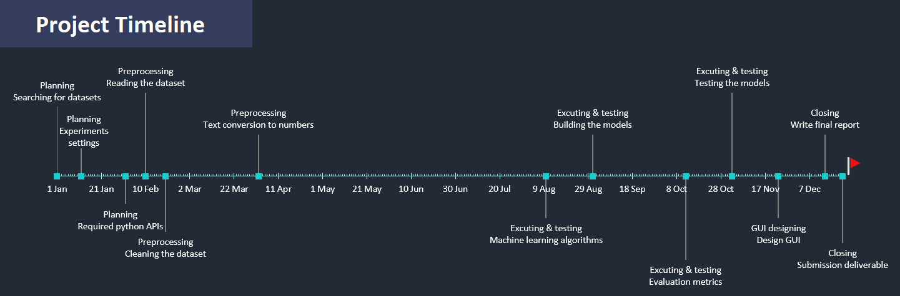
Timeline of the project

Slide 27
Thanks for listening!

